Slide 1
Trade costs, trade flows and CO₂ emissions
Bessie Bao & Joanna Wang

Slide 2
Table of contents
PAPER 1: GEOGRAPHY, TRANSPORTATION, AND ENDOGENOUS TRADE COSTS
By Giulia Brancaccio, Myrto Kalouptsidi, and Theodore Papageorgiou
PAPER 2: TRADE COSTS, CO2, AND THE ENVIRONMENT
By Joseph S. Shapiro

Slide 3
PAPER 1: GEOGRAPHY, TRANSPORTATION, AND ENDOGENOUS TRADE COSTS
By Giulia Brancaccio, Myrto Kalouptsidi, and Theodore Papageorgiou
Contents of interest:
Interaction between the market for transportation services and the market for world trade in goods
Elasticity of trade with respect to shipping costs
Estimation of the relationship between equilibrium trade costs and trade flows
Methodology:
OLS and LIML regression estimations (elasticity)
Matching function and gravity equation (relationship)

Slide 4
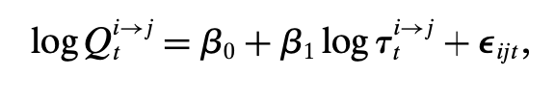
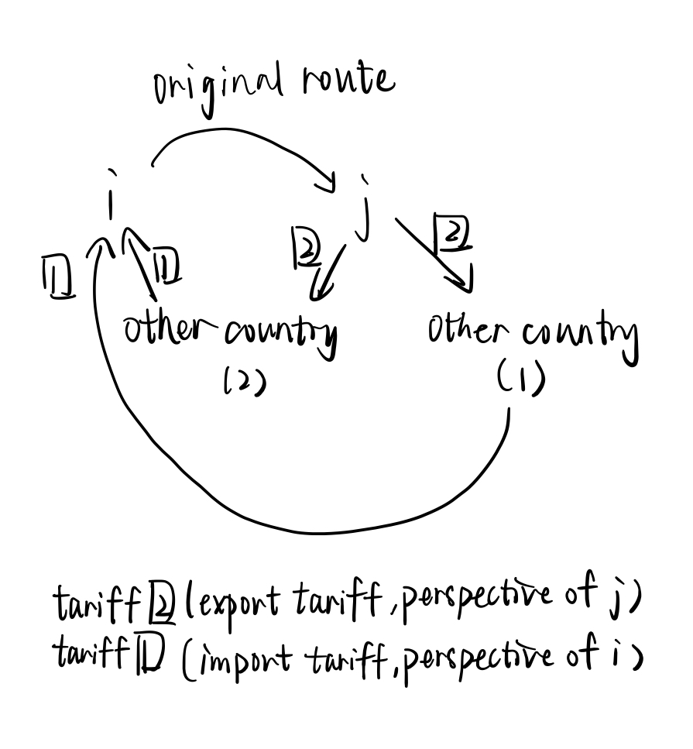
Methodology
Target: 5398 dry bulk ships in the world, 12,007 shipping contracts between 2012 and 2016.
Data Source: contract data collected by Clarksons Research
Trade elasticity equation:
2 instrument variables:
Tariffs ① levied on commodities imported at the exporter’s origin, i
Tariffs ② levied on commodity exports from the destination j.
* Both tariffs do not directly affect i to j flow!
relationship exists between τ^{i→j}_{t} and error term
Q^{i→j}_{t}: total trade value from country i to country j at time t (in bulk commodities)
τ^{i→j}_{t}: shipping price from i to j at time t.

Slide 5
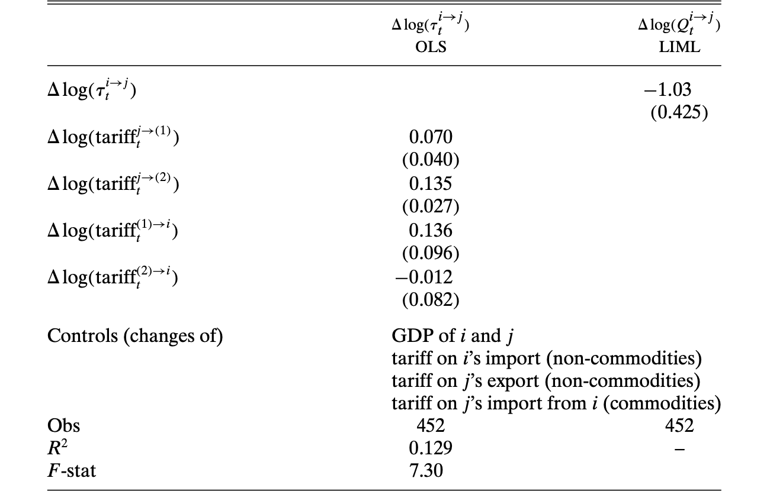
Table of elasticity of trade with respect to shipping prices
F-stat (<10): weak instrument problem
Statistically significant trade elasticity with respect to shipping price (1% δprice → 1.03% -δtrade flows)

Slide 6
Methodology: Matching function
Exploration of the relationship between trade flows and shipping price when prices are formed by the optimizing behavior of forward-looking ships and exporters.
Assumptions:
Matching function is local so that an exporter meets a ship only if they are in the same region
Exporter valuations are sufficiently high → match is always formed between a ship and an exporter in equilibrium
Homogenous bulk ships follows constant returns to scale (similar shipping regions and products, no ship-related factors that have explanatory power in price regressions)
Agents’ strategies and value functions depend only on their own state and the long-run average aggregate state
Trade costs include transport cost, tariffs and all other barriers.
Rough process:
Value functions with respect to ships and exporters → trade costs (shipping prices) → trade flows
Source: AIS data (automatically broadcast info of ships: position, speed, etc.) from ExactEarth Ltd in the Clarksons' dataset (Paper P7 paragraph 1)

Slide 7

Methodology: Matching function (Environment)
Number of matches at region i time t
Agree on a price and start voyage
s_{it}: number of unmatched ships in region i at time t
e_{it}: number of unmatched exporter in region i at time t
λit:= mit/sit probability that an unmatched ship in location i meets an exporter
λeit: = mit/eit probability that an unmatched exporter in location i meets a ship
Assumptions:
* Continuous and strictly increasing
* constant return to scale
* s and e independent
s meet e
Exporter: remain unmatched and wait for another ship
Ship:
1. remain unmatched in the current region
2. ballast elsewhere

Slide 8

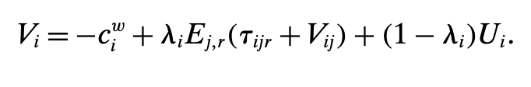
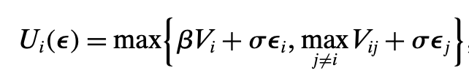
Methodology: Matching function (Ship side)
General value function for the ships:
Vij: value of a ship that travels from i to j (empty/loaded)
cij: per-period sailing cost
dij: probability of a traveling ship arrives at j
β: discount factor
Vj: value of a ship as it begins unmatched.
Vi: value of a ship that starts the period at port in location i
λi: probability of getting matched
Ej,r: expectation index with respect to revenue and destination of the ship
τijr: agreed-upon price received by the ship
Ui: value of being unmatched
Value function for unmatched ships
Either stay in the current position value Vi or choose another region and begin its trip
ε: shocks
σ: standard deviation
*Both values drawn from a type-I extreme value (Gumbel) distribution

Slide 9
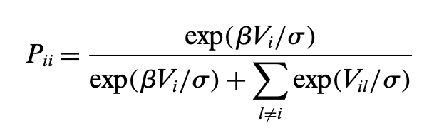
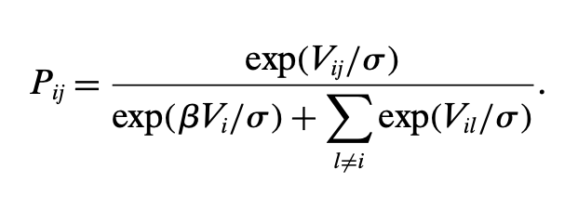
Methodology: Matching function (Ship side)
Probability of the ship movements
Pii: probability that a ship in location i chooses to remain there
Pij: the probability it chooses to ballast to j

Slide 10

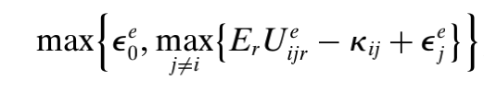
Methodology: Matching function (Exporter side)
Value of an unmatched exporter
Potential entrants
δ : probability of survival of exporters that remain unmatched, δ> 0 and the exporter will wait in their current region.
λeit: probability with which an unmatched
exporter meets a ship (mit/eit)
r: revenue
τijr: agreed price
τijr: total payoff
κij: production and export cost
Er: expectation index with respect to revenue.
* Entrants also subject to iid shocks ϵ
* Each potential entrant makes a discrete choice between destinations, as well as not exporting

Slide 11
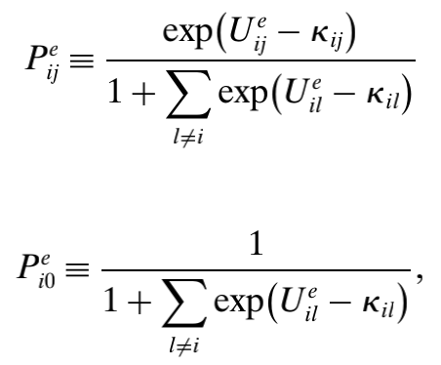

Methodology: Matching function (Exporter side)
Potential exporters' behavior
Number of entrant exporters at location i
* Ueij = Er* Ueijr
εi: number of potential exporters
Er: expectation index with respect to revenue.
Pij: probability of the exporter remain unmatched
Pi0: probability of the exporter remaining there.

Slide 12

Methodology: Matching function (Trade Cost)
Surplus sharing condition: rents generated by a match between an exporter and a ship are split via Nash bargaining.
Lemma 1 (equilibrium price)
τijr: agreed-upon price between a ship and an exporter with valuation r and destination j in location i
λeit: probability with which an unmatched exporter meets a ship
Vij: the value of a ship that starts the period traveling from i to j
δ: exporter survival rate (0.99)
γ :∈ (0,1) the exporter’s bargaining power.
β : discount factor (0.995)
Ueijr: value of an exporter that remains unmatched
Ui = Er*Ui(ε), "outside option" (remain unmatched or balast elsewhere)
Er: expectation index with respect to revenue.
"Price is a convex combination of the exporter’s revenue, r, and the difference between the ship’s value of transporting the freight, Vij, and its outside option, Ui. Shipping price depends on all countries, rather than just i and j."

Slide 13
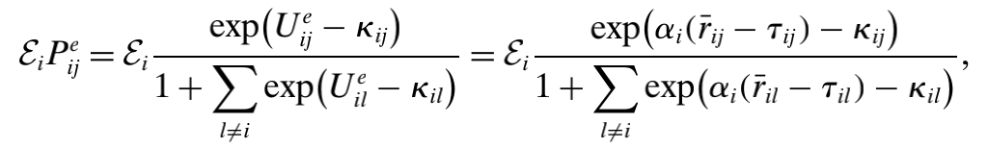
Methodology: Matching function (Trade Flow)
Total flow
rij: average revenue from exporting from i to j
Er: expectation index with respect to revenue.
τijr: agreed-upon price between a ship and an exporter with valuation r and destination j in location i
τij ≡ Er*τijr
αi = βδλei /(1−βδ(1 − λei ))
εi: number of potential exporters
A gravity equation of 2 components:
1. the primitives {λei, rij, kij, Ei}
2. the endogenous trade costs, τij, for all j

Slide 14
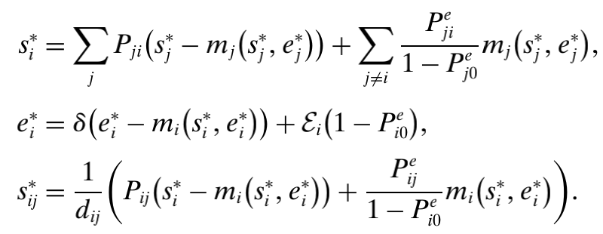
Methodology: Matching function (Steady-state Equilibrium)
SSE condition
(i) ship optimal behavior, Pij (from eq. Pii & Pij)
(ii) potential exporter behavior, Peij (from eq. Peii and Peij)
(iii) prices τijr is determined by Nash bargaining (from eq. τijr)
(iv) ships and exporters satisfy the steady-state equations

Slide 15
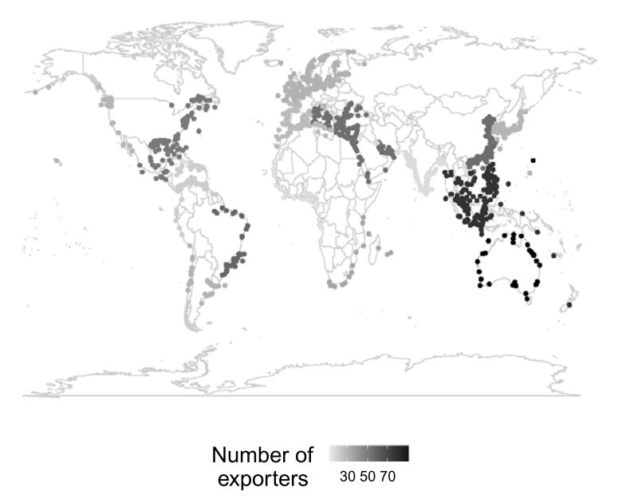
Result: Matching function
Concentration of exporter
Matching rate for ships (exporters) declines as the market gets crowded with ships (exporters).
Exporters are concentrated in Australia, the East Coast of North and South America, and Southeast Asia, which are all rich in raw materials. India, Africa, and Central America have the fewest exporters.
Average weekly number of estimated exporters.

Slide 16
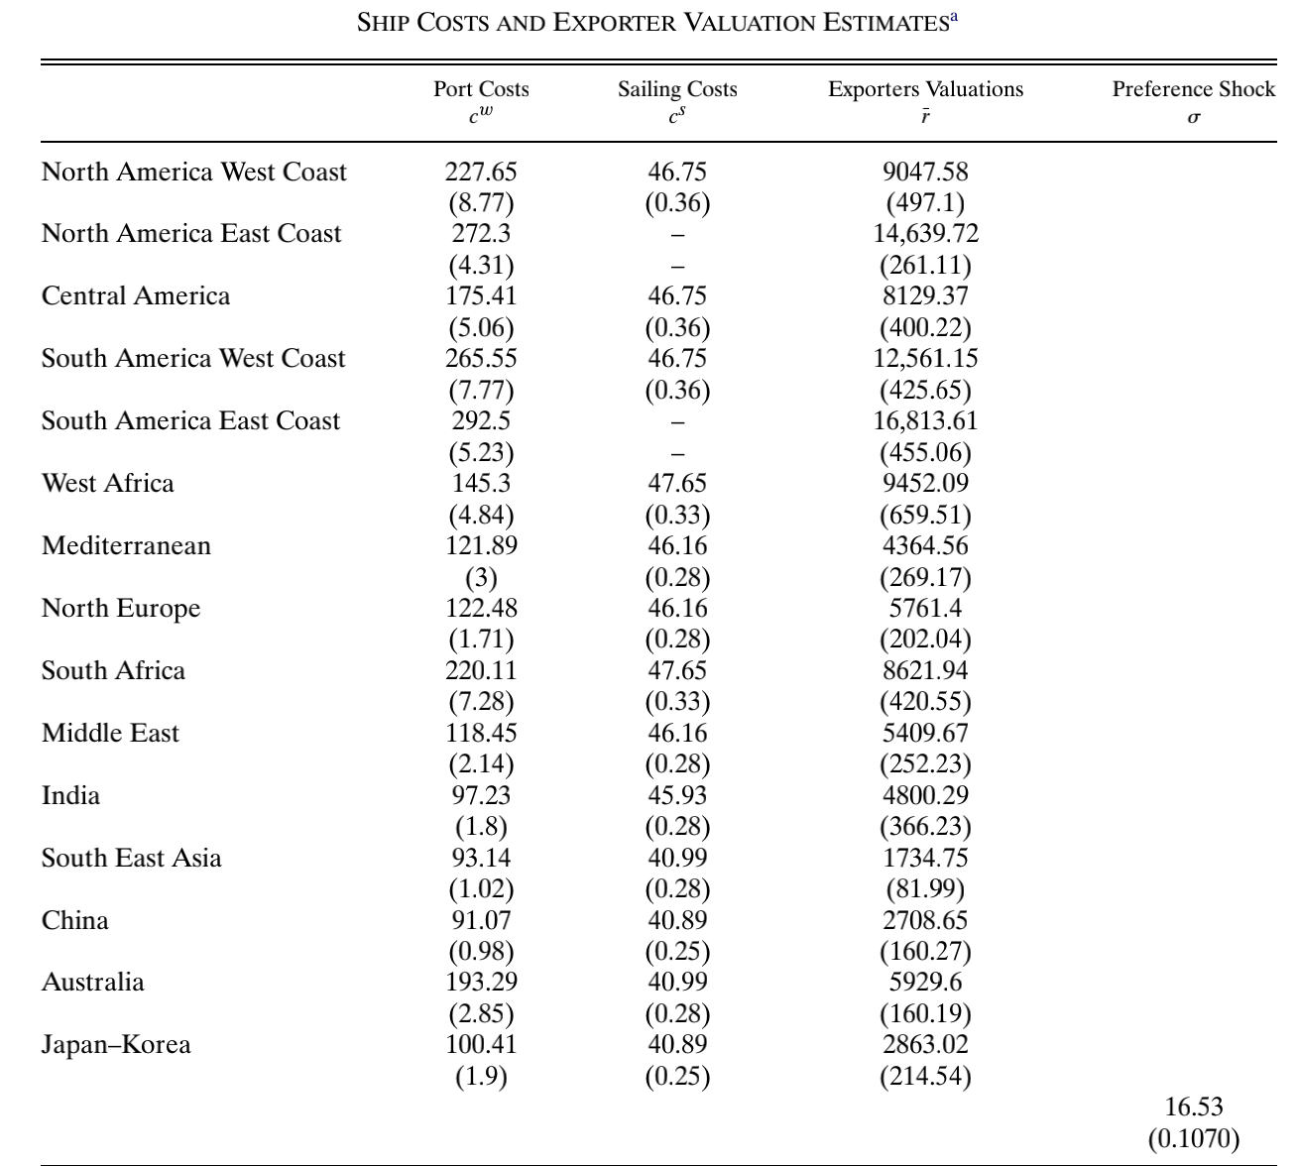
Result: Exporter Revenue & Ship Costs
Fairly homogeneous sailing costs
More heterogeneous and larger port wait costs (eg: direct port and security fees, rapid depreciation of the ship’s machinery and electronics and antifouling costs caused by the accumulation of microorganisms during immobility).
Heterogenous exporter revenues across spaces.
Substantial heterogenous exporter costs (κij) across destinations from a given origin, as well as across origins.

Slide 17
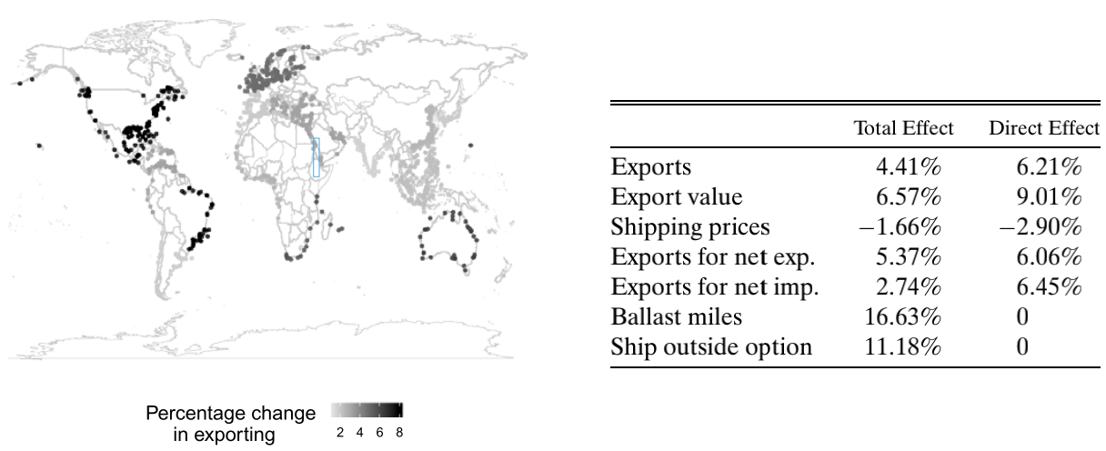
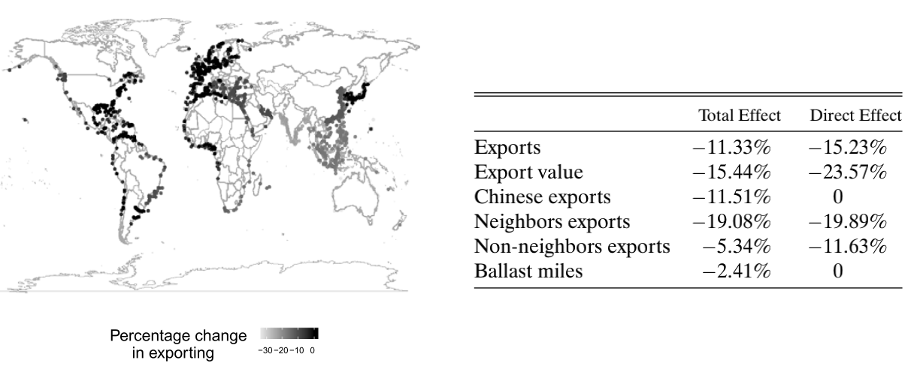
Shock and World Trade (fuel cost and shipping price)
Shock to fuel cost
1. direct: lower fuel cost ->lower variable cost-> lower shipping price
2. indirect: lower fuel price -> lower ballast cost-> higher bargain position of ships -> higher price
Both net exporter and importer export more -> increase in world trade; if no adjustment, would be twice
Chinese Slow-Down
Revenue of freight to China declined -> trade partner experience substantial decline in their export -> fewer ships end up in China, ships reallocate to other parts of the world -> pushing up exports there -> dampening the overall decline in world trade from direct effect.
Results hold in short/medium run

Slide 18
PAPER 2: TRADE COSTS, CO2, AND THE ENVIRONMENT
By Joseph S. Shapiro
Contents of interest:
CO₂ emissions from trade
Trade elasticity with respect to shipping costs
Methodology:
Model of Trade and Environment (basic idea)
Panel data regressions (trade elasticities w.r.t shipping prices for sectors)
“Structural gravity” literature in trade--a model based on reduced-form studies abstract from general-equilibrium forces, (eg: estimates of a few key elasticities, gains & environmental costs of trade, CO₂ emissions from countries in autarky.

Slide 19
Model of Trade and Environment (Armington (1969) model)
Target:
13 tradable sectors and 1 non-tradable sector of production, goods' shipping information of 128 countries to Australia and the United States.
Data Source: national commerce offices and public records
General assumptions:
Fixed labor force L (determines production) and a representative agent .
Produces one variety per sector. (Varieties differentiated by country of origin)
CO2 emissions depend only on equilibrium production and consumption decisions

Slide 20
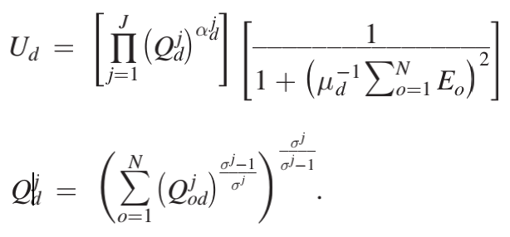
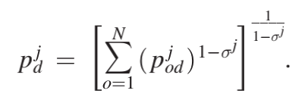


Model of Trade and Environment （Primitive Assumptions)
Assumption 1 (Preferences):
Constant elasticity of substitution (CES) preferences of consumers over varieties within a sector
Cobb-Douglas preferences across sectors, and experience quadratic damage from carbon emissions
Disutility from CO2 emission
Direct Utility Function
Price Index of sector j from d
Utility from consuming goods
price for sector j produced in o sold in d
* Assume CO2 emission pure externality
σ j : Elasticity of substitution between sector j good; σ j > 1
αdj: share of country d's expenditure on sector j
Eo: total CO2 emission from o
μd: social cost of CO2 emission (quantifies magnitude of climate changes)
A CES aggregate of the varieties Qjod: trade from origin o to destination d of sector j goods
Features:
1. Allows expenditure shares αdj and climate damages μd to vary across countries.
2. Not allow elasticities of substitution σ j to vary by country.

Slide 21
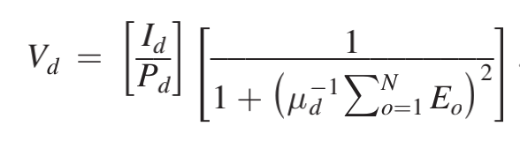
Model of Trade and Environment （Primitive Assumptions)
Assumption 1 (Preferences):
Constant elasticity of substitution (CES) preferences of consumers over varieties within a sector
Cobb-Douglas preferences across sectors, and experience quadratic damage from carbon emissions
Indirect Utility Function
Features:
Allows each country to have different willingness-to-pay for avoiding carbon emissions
social welfare
real income
Social cost of CO₂ emissions ($29/ton, chosen by author)
Environmental damage
Substitutability between environmental goods (carbon emissions) and regular consumption goods

Slide 22
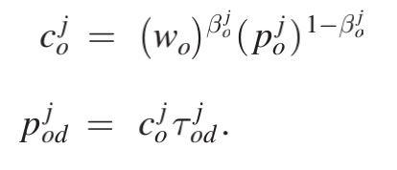
Model of Trade and Environment （Primitive Assumptions)
Assumption 2 (Production Technology and Market Structure): Firms have
Cobb-Douglas production technology and trade costs that take the “iceberg form,” where τodj ≥ 1 units must be shipped for one to arrive
Production cost
wo: price of labor
βjo: share of labor
pjo: price of intermediate good
1-βjo: share of intermediate good
pjod: product price at destination d
cjo: cost of production
τjod: trade cost
* Assume perfect competition

Slide 23
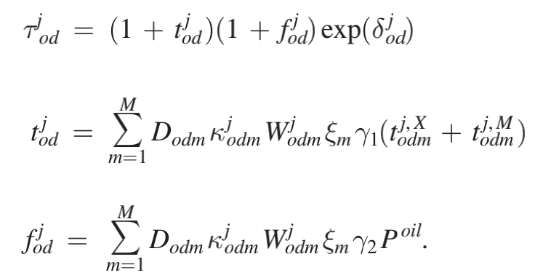
Model of Trade and Environment （Primitive Assumptions)
Assumption 3 (Transportation Technology): decompose the trade cost
δjod: all other bilateral trade friction
Dodm: distance between countries o and d via transportation mode m
κodm: share of o–d trade in dollars transported by mode m
Wodm: weight-to-value ratio for goods traded between countries o and d by mode m
ξm: fuel efficiency of transportation mode m (grams of CO2 emitted per ton-kilo-meter transported)
Poil: global oil price in dollars per barrel of crude
tj,Xodm: carbon tax rate for exports (dollar of tax per ton of CO2)
tj,Modm: carbon tax rate for imports
γ1, γ2: constant convert measurement
Carbon tax per dollar of expenditure:
Fuel cost per dollar of expenditure:
Restrictions:
1. assume perfect competition in the transport sector
2.the counterfactual analyses will treat Dodm, κodm, Wodm, and ξodm as fixed.
Feature:
Allows transportation mode shares to differ by country pair and sector. If transport costs goes up, consumers can purchase goods from other countries that use other transport modes
* Assume oil supply perfect elastic

Slide 24
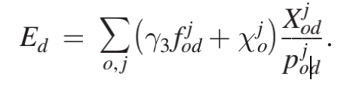
Model of Trade and Environment （Primitive Assumptions)
Assumption 4 (Environment): Trade and production generate CO2 emissions
How trade contributes to carbon emissions by incorporating CO2 emissions from both production and transportation. Accounts for CO2 emissions from all economic activity, and not merely from international trade.
χjo: CO2 emissions per unit of output for sector j in country o
γ3: tons of CO2 emitted per dollar of fuel (constant)
units of goods
produced in country o and consumed in country d
Feature:
Trade can affect pollution intensity (pollution emitted
per unit of output) through changing the the types of transportation used for trade and the locations where goods are produced.
* Assume no economically viable end-of-pipe abatement technologies for CO2 emissions

Slide 25
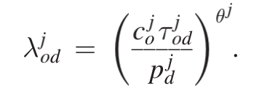






Model of Trade and Environment （Competitive Equilibrium)
Assumption 5 (Market Clearing): Consumers maximize utility, firms maximize profits, and markets clear.
cjo refers to assumption 2 & pjd refers to assumption 1
Demand Stage 1: Cobb-Douglas preferences across sectors mean that each country spends the share αdj on sector j.
Demand stage 2: countries allocate this expenditure across varieties within a sector according to the “gravity” demand:
Profit and utility maximizing expenditure
share of country d’s expenditure on sector j, devoted to goods from producing in country o
share of country d’s expenditure on sector j
Pjd: product price at destination d
θ j ≡ 1 − σ j: key trade elasticity of a large family of gravity models
Income from sector j
Weighted measure of carbon taxes
total expenditure on goods from a sector, sum over intermediate and final goods
Full income: labor earning +tax revenue + net import
carbon tax per dollar of d's export/ import
* Assume trade is imbalanced sector-by-sector

Slide 26
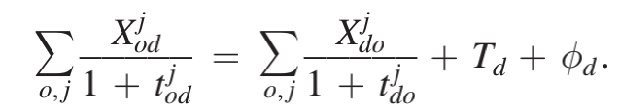


Model of Trade and Environment （Competitive Equilibrium)
Assumption 5 (Market Clearing): Consumers maximize utility, firms maximize profits, and markets clear.
Td: A country’s total net imports across sectors, positive for a country with a trade deficit, a transfer from the rest of the world to country d, which is fixed in counterfactuals.
Φd: international financial flow due to carbon taxes on exports
Market clearing: M=X (Imports=exports)

Slide 27
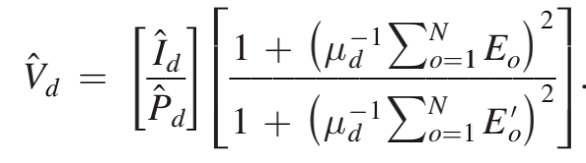

Counterfactual Calculation (Social welfare)
Equivalent variation in terms of proportional change
I_{d}: Income from sector j
Pd: product price at destination d
μ_{d}: Social cost of CO2 emissions ($29/ton, chosen by author)
E_{o}: total CO2 emission from o
unweighted sum of global equivalent variation of each policy
V_{d}: the estimated amount a country would accept, ex ante, to end up with the same utility level that a policy change would provide.

Slide 28
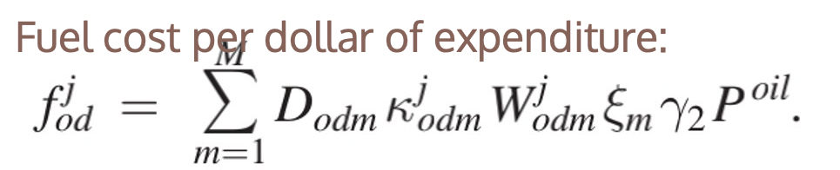
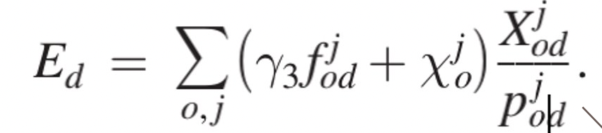

Methodology (Measuring CO₂ emissions)
Intranational and International Distances, and transportation fuel Cost
Source: Geographic information system (GIS) files from the Environmental Systems Research Institute
Procedure (distance):
Create a one-degree grid spanning the globe.
Permit a ship to travel to any cell within three degrees of longitude or latitude, so long as that travel does not cross land.
Apply the Floyd (1962)–Warshall (1962) algorithm to find the shortest path between every pair of ports in the world that measures the sea distance between their respective countries.
* Assume the share of a country’s trade which flows through a given port equals the share of the country’s population for which that port is closest.
pi, pj: total population of grid cells i and j
Go, Gd: sets of cells in countries o and d
Po, Pd: total populations of countries o and d
dij: distances between ports by sea
* Mode shares for 17-26% of international and intranational trade flows. (Source: paper P13)
* Mentioned about calculating fuel consumption for both international and domestic shipping. uses statistical methodology (fractional multinomial logit) with different assumptions and data, no details provided.

Slide 29

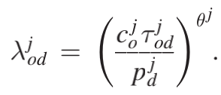
Methodology - Trade Elasticity (Estimation)
total shipping cost (fuel +non-fuel)
Problem with running OLS:
1. omitted non-pecuniary trade barriers (wages, prices) with greater shipping costs and lower trade flows→ negative variable bias on θj
2. measurement error in sody
FE Estimator:
1. exporter-by-year FE: control for production costs coyj
2. importer-by-year FE: control for destination prices pdyj
3. country-pair FE δodj: control for time-invariant components of trade costs (distance)
Problem with FE Estimator:
using fixed effects with panel data address OVB but exacerbate measurement errors.
Feature:
1. Allowing trade flows and prices to vary by year y.
2. Allows for idiosyncratic innovations ϵody in the unobserved
component of trade costs, δod. (error term)
3. sody: total shipping costs, proportional to fuel costs under Assumption 3

Slide 30
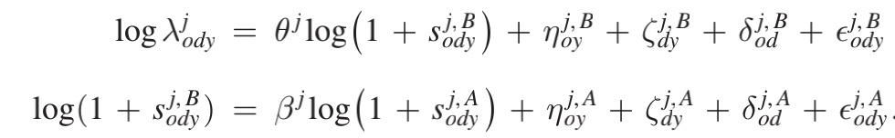
Methodology - Trade Elasticity (Estimation)
IV Estimator (Resolves 1. reverse causality; 2. OVB):
Leads and lags of shipping cost variables as instruments
For each year of data, make two measures of each variable:
One contains data aggregated from Q2, Q3 of the year, second containing Q1 Q4. For each year, then use mean reported shipping costs from Q2 Q3 as an IV for reported shipping costs from Q1 Q4
* Assume measurement error in 2 samples independent, if fail ME persists
shipping cost Q2 Q3
Shipping cost Q1 Q4
Results:
Instrumental variable estimates of the trade elasticity all have the expected negative signs and moderate magnitudes (mean across sector: -8.16)
Fixed effects model with full-year aggregated data: average elasticity across sectors of −3.95 and a range from −1.19 to −7.33
Mean elasticity across sectors: −6.26
Including origin fixed effects, destination fixed effects, and year fixed effects

Slide 31

Counterfactual – CO2 Emission of countries in Autarky
Calculating CO2 Emission of a country in Autarky
fddj, χdj: emission data, indicate the intensity of CO2 from domestic transportation and production, respectively.
βdjXd: expenditure in the baseline data
λddj: effect on output of going to autarky.
βjd: share of labor
θj: key trade elasticity of a large family of gravity models
* All terms on the right-hand side are observed in the
baseline data, i.e., none represents a number only observed
in a counterfactual.
Result
International trade increases global CO2 emissions by 5 percent (1.7 gigatons of CO2 annually). Globally this effect is almost equally driven by production and transportation.
Autarky only directly affects shipping. The autarky counterfactual in this section accounts for changes in CO2 emissions from international shipping, domestic shipping, and production, which result from shutting off international trade.

